Slide 1
Going Live
Day 4
April 25, 2016

Slide 2
Check-Up Session
How’s it going?
After 1 week of Bootcamp, how are you holding up?
What feedback do you have so far?
Notes:
Gather feedback on topics like pace, content, challenges, etc. Explain that as a team we have to rely on feedback from each other to segway

Slide 3

Instructor Feedback
Seriously, mind-blown.
Notes:
I’m seriously impressed by the everybodys hard work and collaboration. This is seriously tough stuff we are learning here today and very quickly, and you have all show a fearlessness in tackling this challenge, applaud!

Slide 4
Instructor Feedback
Things I’ve noticed people doing incredibly well:
All of you are handling an enormous volume of information.
All of you are asking the right questions…
Noticing the right details…
Helping others…
And, most importantly, you are not giving up.

Slide 5
A Few Admin Things…

Slide 6
Instructor Feedback
Remember, Homework #1 is due on Wednesday / Thursday.
Homework Link: http://bootcampspot.com/homework/
Remember to submit Homework via GitHub (and Heroku): WHAT LINK GOES HERE???????????????
And seriously!
Submit whatever you have! Don’t get a 0.
(Even if you don’t like what you’ve made.)
Notes:
You may not have the design perfected or there may be bugs or it may even cause your computer to crash when you run it but please PLEASE submit your homework… I always save my work before checking homework, But seriously you do not want to fall behind and miss two homework submission and miss our on career services.

Slide 7
Office Hours + Additional Help
Also, remember….
In Class Office Hours: 45 minutes before class, 30 minutes after
Review In Class Material (Exercises and Slides): https://github.com/the-Coding-Boot-Camp-at-UT-Austin/04-16-Class-Content
Re-Watch Class Videos:
https://github.com/the-Coding-Boot-Camp-at-UT-Austin/04-16-Class-Content - in readme
Questions over Slack: Please reach out. We may not always respond right away but we will respond.

Slide 8
Recapping

Slide 9

Recap
In just one whirlwind week we’ve covered:
Full-Stack Development Conceptually
Terminal / Git Bash
HTML Syntax
Git Concepts and Commands
CSS Purpose, Syntax, and Styles
Floating
Positioning
Box Model
Google Dev Tools
How to learn on Your own!!
Notes:
Have them define full stack dev, ask quick console questions, ask what github prevents Pick a random name,

Slide 10
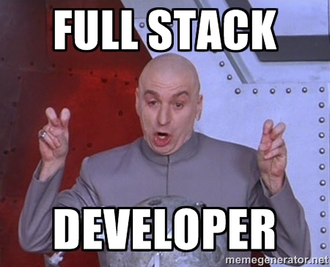
Full-Stack Development?

Slide 11

> Intro to Console

Slide 12


<title> Intro to HTML </title>
HTML is one of the three base languages behind every single website.
It defines all of the basic content and a bit of formatting.

Slide 13



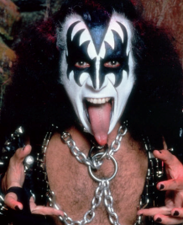

Pushing and Pulling to GitHub
1
2
3
4
GitHub Branch
Pull Code
Push Code
Pull Code
Pull Code
Push Code
Pull Code
Push Code

Slide 14

CSS Syntax
CSS works by hooking onto selectors added into HTML using “classes and identifiers”.
Once hooked, we apply styles to those HTML elements using css .

Slide 15

The Concept of “Flow”
In HTML/CSS, (by default) every element displayed is governed by a concept called “flow”.
This means that HTML elements force their adjacent elements to flow around them.

Slide 16
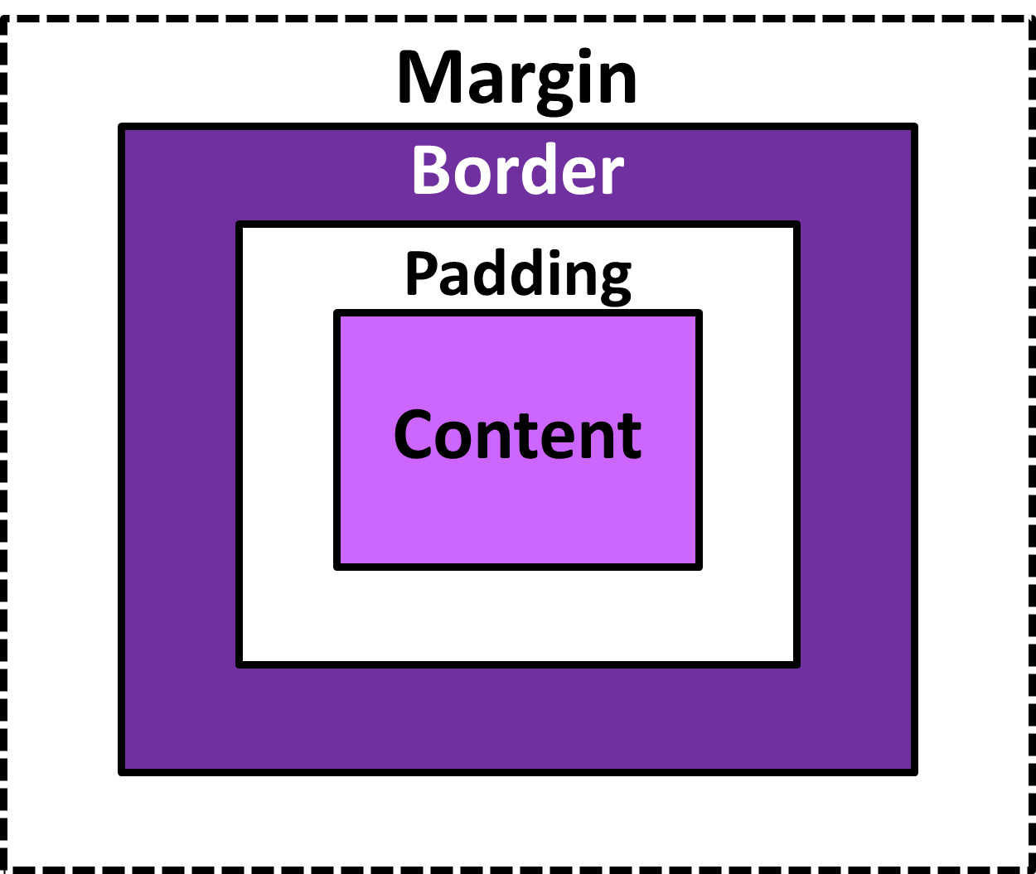
The Box Model
The Box Model wraps every CSS element in padding, border, and margin – allowing micro changes of spacing.

Slide 17

CSS Positioning
Through CSS positioning (static, relative, fixed, absolute) we can orient our html elements in relation to space.

Slide 18





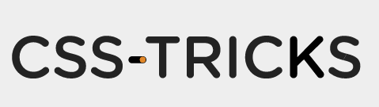



How to Learn…

Slide 19

How to Troubleshoot…
The console window in the browser inspector.
Something New: HTML and CSS validation
https://validator.w3.org/

Slide 20

General Questions / Issues?

Slide 21
Double Take

Slide 22
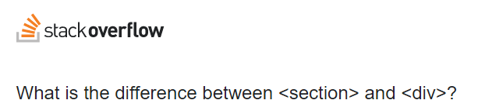
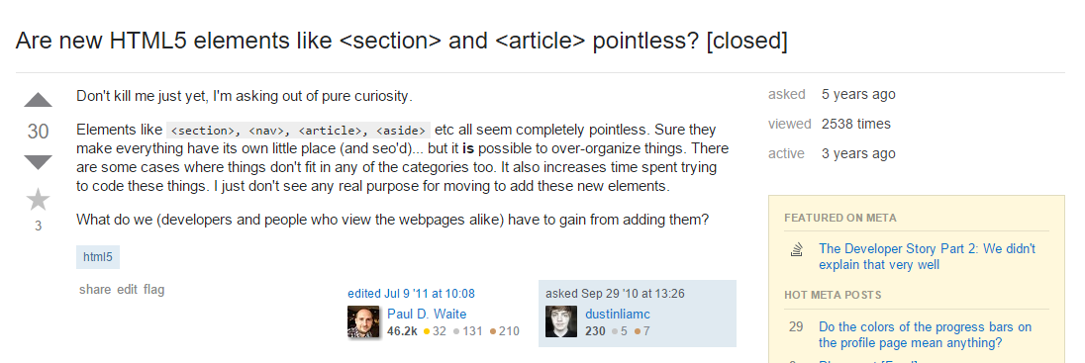
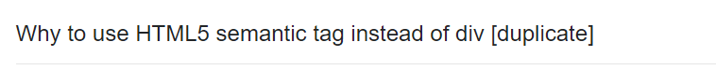
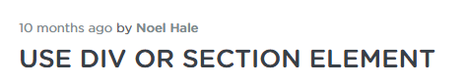
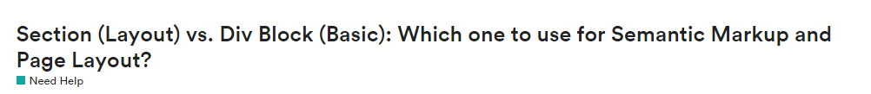
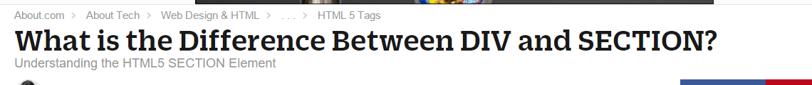
Divs, Sections, Navs, Etc….
Notes:
Common Question about divs, vs html5,

Slide 23
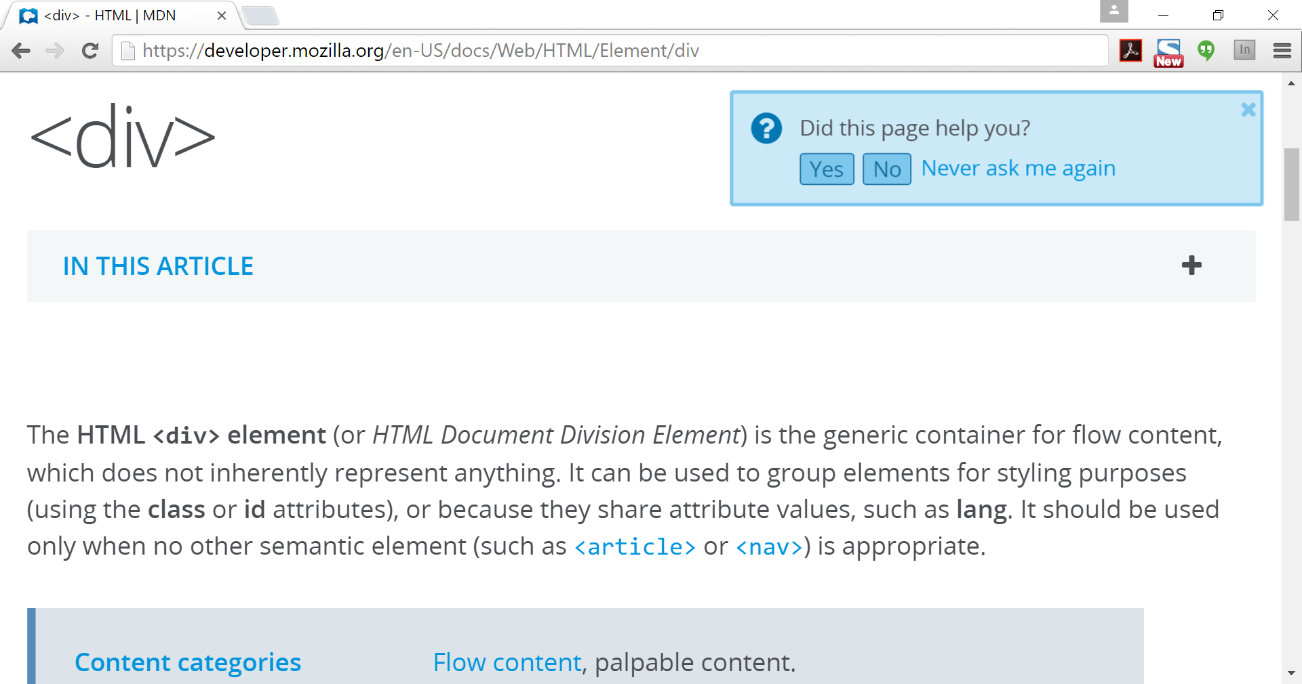
Definition of a DIV
https://developer.mozilla.org/en-US/docs/Web/HTML/Element/div

Slide 24
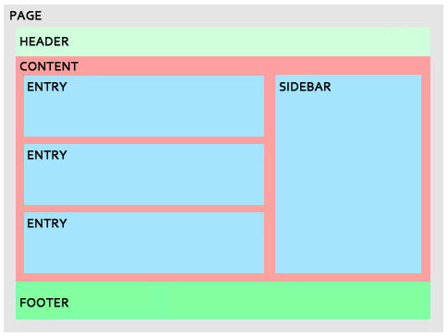
Divs, Sections, Navs, Etc….
Fundamentally, all web layouts are composed of containers, traditionally called “divs”.

Slide 25
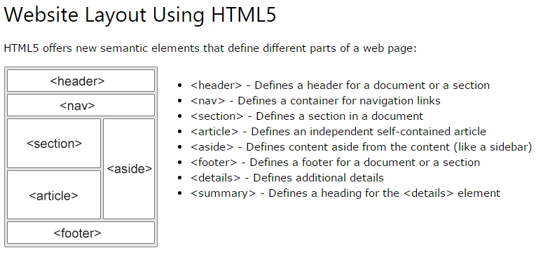
Divs, Sections, Navs, Etc….
HTML5 introduced the concept of “semantic layouts” meaning “divs” could be given more “meaningful names.”
In theory, this helps with organization and search engine optimization.

Slide 26
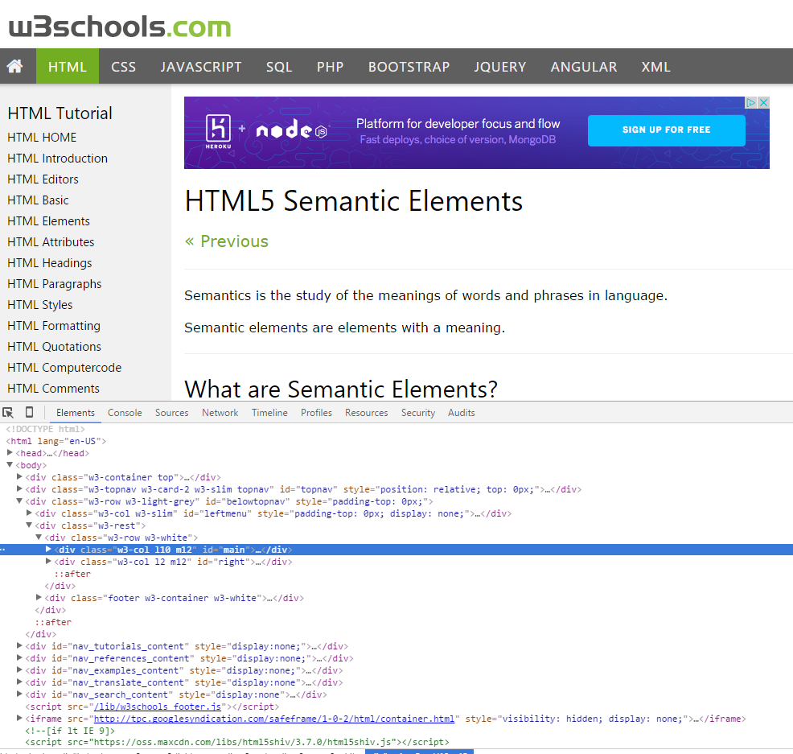
Divs, Sections, Navs, Etc….
That said… many (if not most) websites, seem to still be using basic divs.
There are reasons for this that we’ll showcase in later sections.
Additionally, it’s possible to include “semantics” by using id names and classes.

Slide 27
Divs, Sections, Navs, Etc….
div?
Section?
Bottom line: Follow your homework’s instructions. But when you get out in the “real world”, follow the convention of where you work!

Slide 28

Classes vs. IDs
Classes = Barcode (all IPod)
IDs = Serial Number (unique Ipod)
When choosing between a CSS ID and a CSS Class follow the convention:
Classes (.classname) are to be used if the same style will be used on multiple HTML elements
IDs (#idname) are to be used if a style is unique to that HTML element.

Slide 29
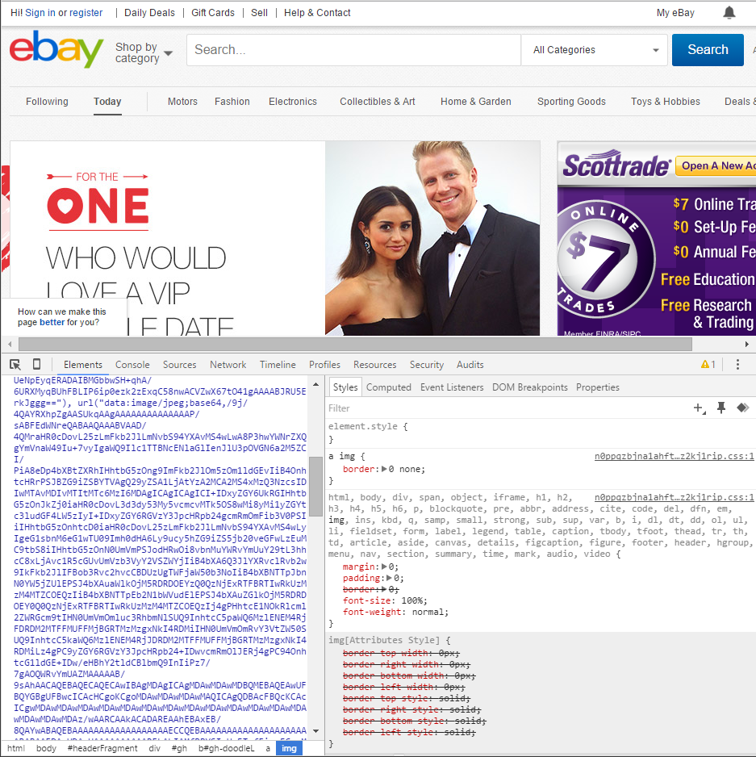
Google Developer Tools (Inspector)
GDT is one of the most frequent tools you will use in web dev.
It allows you to truly, debug your web designs.
Start using it!

Slide 30

Modifying Sites
Using Chrome Inspector you can readily edit any webpage (your own or otherwise) to see the immediate impact of HTML or CSS changes

Slide 31
INSTRUCTOR DEMO!
Instructor: Demo
(Google Developer Tools)

Slide 32
> YOUR TURN!!
Suggested Time: 15 min
Assignment
For the next 15 minutes, take a website that you commonly use (Amazon, Google, Huff Po, etc.) and heavily modify it using the Google Developer Tools.
Be sure to at least modify:
Content (Change words)
Colors
Spacing
Etc.
Send a screenshot to the class’ slack profile when you’re done.

Slide 33
> YOUR TURN!!
Suggested Time: 10 min
Assignment
For the next 10 minutes, take any site that you’ve been working on in-class or for homework, and utilize Google Developer Tools to help you “test changes”.
Be sure to at least modify:
Content (Change words)
Colors
Spacing
Etc.

Slide 34
CSS Resets

Slide 35

Loading Multiple CSS Files ***(Very Important!!!)***
One of the most powerful aspects of CSS is the ability to deploy multiple CSS files simultaneously.
This allows developers the ability to create complex designs – made up of multiple design elements.
Just remember the loading order matters!!!
Notes:
Discuss source order and reflow, show in inspector

Slide 36
INSTRUCTOR DEMO!
Instructor: Demo
(1-3_CSSFiles.html | 1-MultipleCSS)
Notes:
Open code and

Slide 37
What Browser?
By a show of hands…
Which browser do you use?
Notes:
Ask which browser they use… end with opera or seamonkey

Slide 38
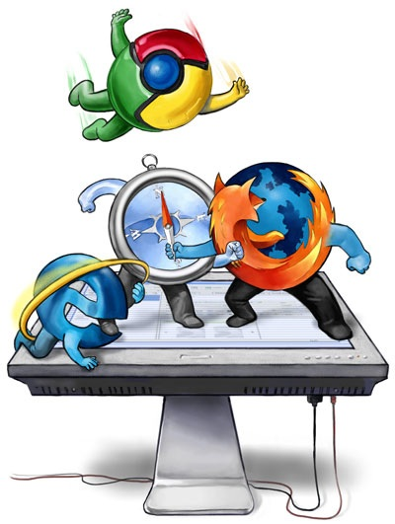
Battle of the Browsers
Under-the hood there are often significant differences between how browsers render webpages.
These differences in rendering agents can mean HTML/CSS gets displayed differently in each.
As designers/developers, creating cross-browser compatible websites is critical.
Notes:
Without our intervention the browser decides how a header or a or blockquote tag should be styled. Does anyone remember what the browsers contribution to the style is called? Resets help fix the user agent differences and valid html and css helps prevent bugs.

Slide 39

Reset.css (or Normalize.css)
Reset.css ensures that all browser-specific css has been reset, so it appears the same in all browsers.
http://meyerweb.com/eric/tools/css/reset/reset.css https://necolas.github.io/normalize.css/4.1.1/normalize.css
This means you will have to re-style everything yourself
Notes:
When you reset you attempt to start at a baseline value for all your elements, zero-out, you make allowances for html5 tags some browsers might not recognize, and you attempt to fix browser bugs. LOOK AT THE FILES, opinionated simple means the developers did this, this way because they prefer to write code or develop a certain way. Usually the better way. Important when we get to frameworks, which are abstractions of programming languages, they were made to be used one way – and they work great that way, deviate and they are not so great.

Slide 40
INSTRUCTOR DEMO!
Instructor: Demo
(Example.html | 2-ResetCSS)
Notes:
Demo without reset.css and with –

Slide 41
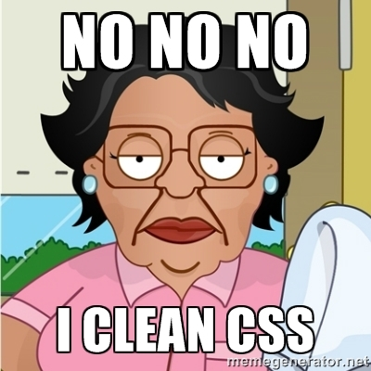
Why CSS Resets Matter
It’s important for creating browser-compatible websites
It’s an example of using someone else’s CSS in your website!!!
It’s a common Front-End Developer Interview question.
Notes:
we are fixing cross-browsers boo boos, we are using someone else’s code, not reinventing the wheel and learning a cool interview question. Maybe someday all browsers will be chrome, sigh

Slide 42
Why CSS Resets Matter
It’s important for creating browser-compatible websites
It’s an example of using someone else’s CSS in your website!!!
It’s a common Front-End Developer Interview question.

Slide 43
> YOUR TURN!!
Suggested Time: 10 min
Assignment
Follow the instructions given via slack to incorporate a reset.css file into a basic HTML file.
Note the impact the reset file makes after its inclusion.

Slide 44
To the Web with Heroku!

Slide 45
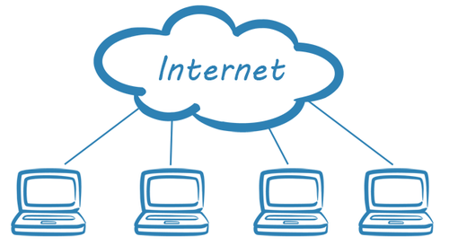
The Internet
A deep and complex diagram above on how the internet works.

Slide 46

The World Will See Our Greatness!
Heroku provides a cloud application hosting platform – which means we can deploy our websites and applications onto their servers for the world to see.

Slide 47
Together Now…
Let’s all login to Heroku
Notes:
Lets all login heroku…

Slide 48
INSTRUCTOR DEMO!
Instructor: Demo
(Heroku Deployment)

Slide 49
Deploying Static Websites to Heroku
Basic Steps:
Go to folder you want to host (must be .git enabled)
Add a file called composer.json and include an empty bracket {}.
Add a file called index.php with the following inside:
Run Heroku login (for windows users, remember the workaround!)
Run git remote –v
Run heroku create
Run git remote –v
Run git push heroku master
Notes:
Git remote –v :show the places we can push to. Heroku create :creat the app on heroku and add on a new remote path to git

Slide 50
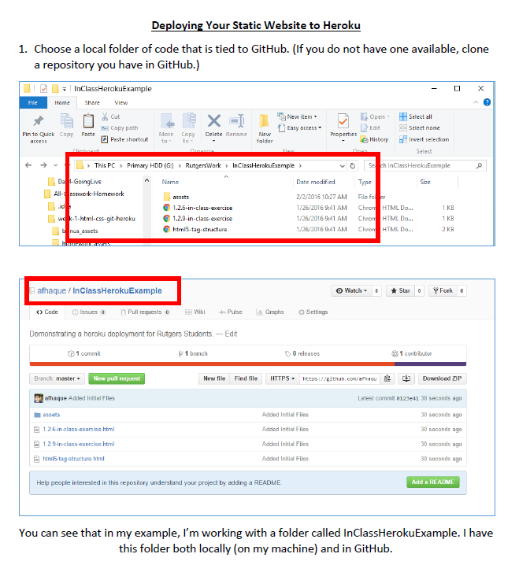
Follow our Guide!
Step-by-step guide on creating Heroku Deployments

Slide 51
> YOUR TURN!!
Suggested Time: 30 min
Assignment
Time to take your newfangled website and deploy it to the cloud. Setup your own instance of Heroku and deploy one of your HTML creations to Heroku.
Additional instructions to be sent via Slack.

Slide 52
Practice Through Frustration
Keep Practicing!
It gets better.

Slide 53
Questions?

Slide 54
Homework 1 - Help?

Slide 55
EXTRA MATERIAL

Slide 56
And Back to Git…

Slide 57

The Group Project
OMG. I HAZ THE GREATEST HTML IDEA!!!!!
SpongeSite.com

Slide 58

The Group Project
Programming Away…
Spongebob’s idea is dumb. We should call it…
PrincezzzSite.com

Slide 59
The Group Project
The Group Project – Tragedy #1
Programming Away…
Now they have two completely different versions.
Programming Away…

Slide 60
The Group Project – Push vs Pull
Main Branch (Spongebob’s)
Spongebob continues programming
1
2
3
4
5
This is NON-IDEAL
Prince pushes his code changes into the main branch.
If Prince is allowed to push his code, it could seriously ruin Spongebob’s vision and working code.
Prince’s Branch

Slide 61
The Group Project – Push vs Pull
Main Branch (Spongebob’s)
Spongebob continues programming
1
2
3
4
5
Prince’s Branch

Slide 62
The Group Project – Push vs Pull
Main Branch (Spongebob’s)
Spongebob continues programming
1
2
3
4
5
Ideal Approach – Using Pull Requests
Because Spongebob controls the “master branch” he must elect to pull Prince’s Code. All Prince can do is submit a “pull request”
This is the ideal way to maintain code in version control.
?
Prince’s Branch

Slide 63
General Steps for Git Pull Requests
Create a new branch of on your local computer git branch <BRANCH NAME>
Checkout that branch (locally) on your machine git checkout <BRANCH NAME>
Add / Commit your changes (will automatically save to this branch) git add –A git commit –m “Comment”
Push your branch to GitHub
git push origin <BRANCH NAME>
Submit a Pull Request on GitHub
Other user must accept these changes on GitHub

Slide 64
INSTRUCTOR DEMO!
Git Pull Request

Slide 65
> YOUR TURN!!
Assignment
Time to take your newfound collaborative git skills to the real-world. Find a partner and follow the steps sent via slack to
Share each other’s code
Make modifications
Submit a Pull Request
Accept the Pull Changes

Slide 66
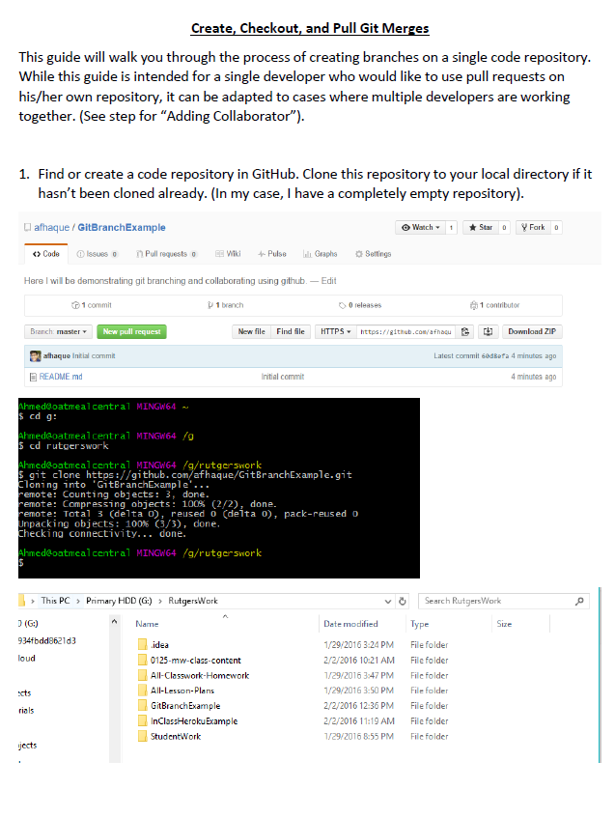
Follow our Guide!
Step-by-step guide on creating Git Pull Requests

Slide 67
Don’t Worry!
We’ll be coming back to this.
You won’t need this fully until Week 8.

Slide 68
Practice At Home
But practice when you can!
You don’t need a partner to submit pull requests

